Slide 1
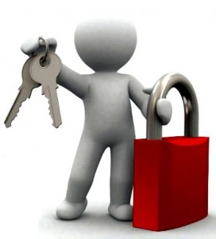
Information Technology Infrastructure
Part 2
Securing Information Systems
MFIS
Lisa Murphy
Notes:
1

Slide 2
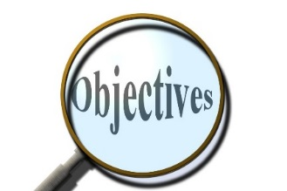
Learning Objectives
LEARNING OBJECTIVES
Week 9
Explain why information systems are vulnerable to destruction, error, and abuse.
Assess the business value of security and control.
Identify the components of an organizational framework for security and control.
Evaluate the most important tools and technologies for safeguarding information resources.
Week 10

Slide 3
Software vulnerability
Commercial software contains flaws that create security vulnerabilities
Hidden bugs (program code defects)
Zero defects cannot be achieved because complete testing is not possible with large programs
Flaws can open networks to intruders
Patches
Vendors release small pieces of software to repair flaws
However, amount of software in use can mean exploits created faster than patches be released and implemented
Notes:
3

Slide 4
Business Value of Security and Control
Lack of security, control can lead to
Loss of revenue
Failed computer systems can lead to significant or total loss of business function
Lowered market value:
Information assets can have tremendous value
A security breach may cut into firm’s market value almost immediately
Legal liability
Lowered employee productivity
Higher operational costs
Notes:
4

Slide 5
IT Law
Electronic evidence
Evidence for white collar crimes often found in digital form
Data stored on computer devices, e-mail, instant messages, e-commerce transactions
Proper control of data can save time, money when responding to legal discovery request
Computer forensics
Scientific collection, examination, authentication, preservation, and analysis of data from computer storage media for use as evidence in court of law
Includes recovery of ambient and hidden data
Notes:
5

Slide 6
Establishing a Framework for Security and Control
General controls
Govern design, security, and use of computer programs and data throughout organization’s IT infrastructure
Combination of hardware, software, and manual procedures to create overall control environment
Types of general controls
Software controls
Hardware controls
Computer operations controls
Data security controls
Implementation controls
Administrative controls
Notes:
6

Slide 7
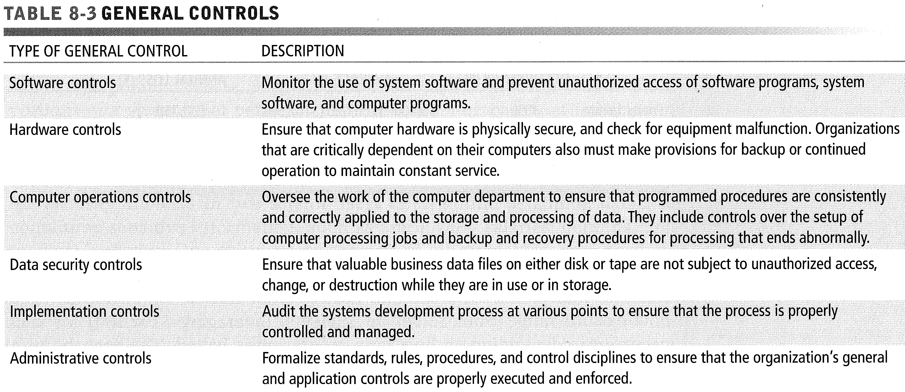
General Controls

Slide 8

Establishing a Framework for Security and Control
Application controls
Specific controls unique to each computerized application, such as payroll or order processing
Include both automated and manual procedures
Ensure that only authorized data are completely and accurately processed by that application
Types of application controls:
Input controls
Processing controls
Output controls
Notes:
8

Slide 9
Risk assessment
Determines level of risk to firm if specific activity or process is not properly controlled
Types of threat
Probability of occurrence during year
Potential losses, value of threat
Expected annual loss
EXPOSURE | PROBABILITY | LOSS RANGE (AVERAGE) | EXPECTED ANNUAL LOSS
Power failure | 30% | $5K - $200K ($102,500) | $30,750
Embezzlement | 5% | $1K - $50K ($25,500) | $1,275
User error | 98% | $200 - $40K ($20,100) | $19,698
Notes:
9

Slide 10
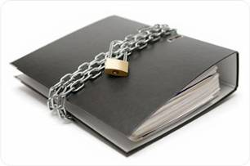
Policy
Security policy
Ranks information risks, identifies acceptable security goals, and identifies mechanisms for achieving these goals
Drives other policies
Acceptable use policy (AUP): Defines acceptable uses of firm’s information resources and computing equipment
Authorization policies: Determine differing levels of user access to information assets
Authorization management systems
Allow each user access only to those portions of system that person is permitted to enter
Notes:
10

Slide 11
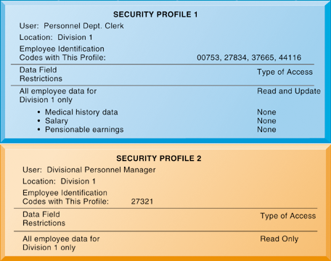
Security Profiles for a Personnel System
These two examples represent two security profiles or data security patterns that might be found in a personnel system.
Depending on the security profile, a user would have certain restrictions on access to various systems, locations, or data in an organization.
Notes:
11

Slide 12
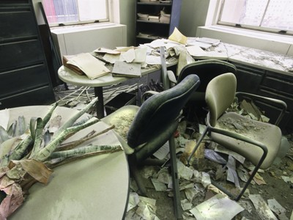
Disaster recovery
Disaster recovery planning:
Devises plans for restoration of disrupted services
Business continuity planning:
Focuses on restoring business operations after disaster
Both types of plans needed to identify firm’s most critical systems and business processes
Business impact analysis to determine impact of an outage
Management must determine
Maximum time systems can be down
Which systems must be restored first
Notes:
12

Slide 13
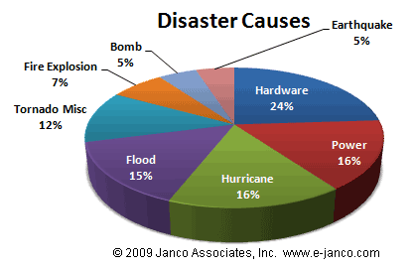
Causes of Disaster
According to Janco Associates, the primary factor in the activation of Disaster Recovery and Business Continuity Plans is computer hardware failure.

Slide 14
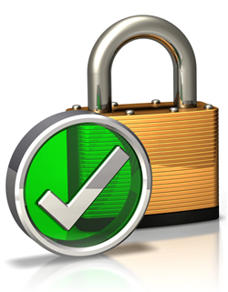
Auditing
MIS audit
Examines firm’s overall security environment as well as controls governing individual information systems
Reviews technologies, procedures, documentation, training, and personnel
May even simulate disaster to test response of technology, IS staff, other employees
Lists and ranks all control weaknesses and estimates probability of their occurrence
Assesses financial and organizational impact of each threat
Notes:
14

Slide 15
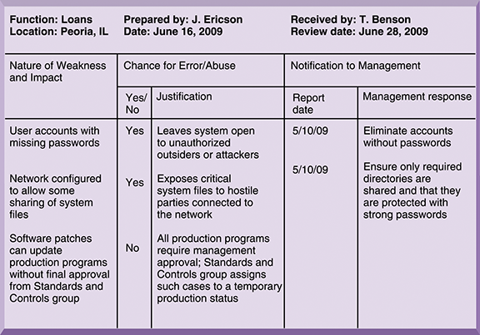
Sample Auditor’s List of Control Weaknesses
This chart is a sample page from a list of control weaknesses that an auditor might find in a loan system in a local commercial bank.
This form helps auditors record and evaluate control weaknesses and shows the results of discussing those weaknesses with management, as well as any corrective actions taken by management.
Notes:
15

Slide 16
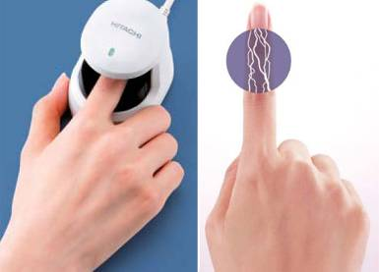
Technologies and Tools for Security
Access control: Policies and procedures to prevent improper access to systems by unauthorized insiders and outsiders
Authorization
Authentication
Password systems
Tokens
Smart cards
Biometric authentication
Notes:
16

Slide 17

Firewalls
Firewall: Hardware and/or software to prevent unauthorized access to private networks
Screening technologies
Packet filtering
Stateful inspection
Network address translation (NAT)
Application proxy filtering
Intrusion detection systems: Monitor vulnerable points on networks to detect and deter intruders
Examines events as they are happening to discover attacks in progress
Scans network to find patterns indicative of attacks
Notes:
17

Slide 18
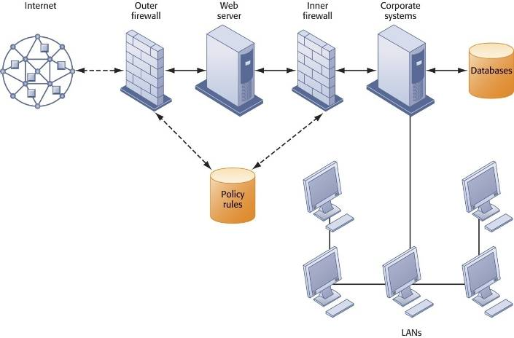
A Corporate Firewall
The firewall is placed between the firm’s private network and the public Internet or another distrusted network to protect against unauthorized traffic.
Notes:
18

Slide 19
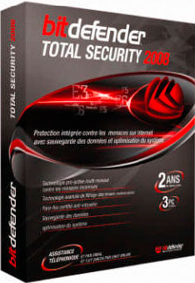
Protection Software
Antivirus and antispyware software:
Checks computers for presence of malware and can often eliminate it as well
Require continual updating
Unified threat management (UTM):
Comprehensive security management products
Tools include
Firewalls
Intrusion detection
VPNs
Web content filtering
Antispam software
Notes:
19

Slide 20
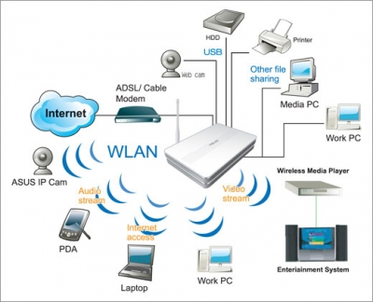
Securing wireless networks
WEP security can be improved:
Activating it
Assigning unique name to network’s SSID
Using it with VPN technology
Wi-Fi Alliance finalized WAP2 specification, replacing WEP with stronger standards
Continually changing keys
Encrypted authentication system with central server
Notes:
20

Slide 21
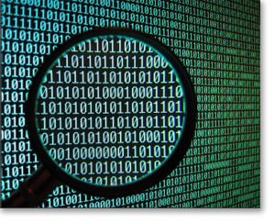
Encryption
Encryption
Transforming text or data into cipher text that cannot be read by unintended recipients
Two methods for encrypting network traffic
Secure Sockets Layer (SSL) and successor Transport Layer Security (TLS)
Secure Hypertext Transfer Protocol (S-HTTP)
Two methods of encryption
Symmetric key encryption
Public key encryption
Notes:
21

Slide 22
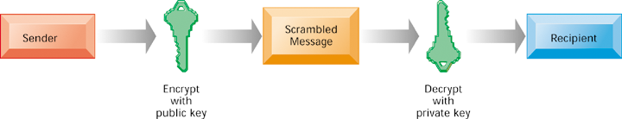
Public Key Encryption
A public key encryption system can be viewed as a series of public and private keys that lock data when they are transmitted and unlock the data when they are received.
The sender locates the recipient’s public key in a directory and uses it to encrypt a message.
The message is sent in encrypted form over the Internet or a private network.
When the encrypted message arrives, the recipient uses his or her private key to decrypt the data and read the message.
Notes:
22

Slide 23
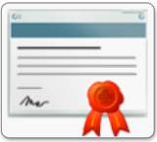
Digital Certificates
Digital certificate:
Data file used to establish the identity of users and electronic assets for protection of online transactions
Uses a trusted third party, certification authority (CA), to validate a user’s identity
CA verifies user’s identity, stores information in CA server, which generates encrypted digital certificate containing owner ID Use of public information and copy of owner’s public key
Public key infrastructure (PKI)
key cryptography working with certificate authority
Widely used in e-Commerce
Notes:
23

Slide 24
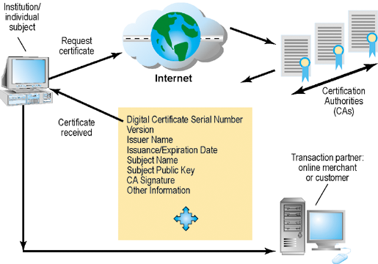
Digital Certificates
Digital certificates help establish the identity of people or electronic assets.
They protect online transactions by providing secure, encrypted, online communication.
Notes:
24

Slide 25
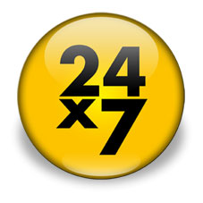
System Availability
Ensuring system availability
Online transaction processing requires 100% availability, no downtime
Fault-tolerant computer systems
For continuous availability
Contain redundant hardware, software, and power supply components to provide continuous, uninterrupted service
High-availability computing
Helps recover quickly from crash
Minimizes, does not eliminate downtime
Notes:
25

Slide 26
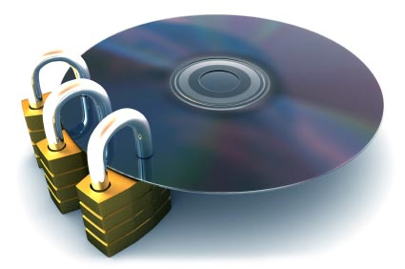
Recovery
Recovery-oriented computing
Designing systems that recover quickly with capabilities to help operators pinpoint and correct of faults in multi-component systems
Controlling network traffic
Deep packet inspection (DPI)
Security outsourcing
Managed security service providers (MSSPs)
Notes:
26

Slide 27
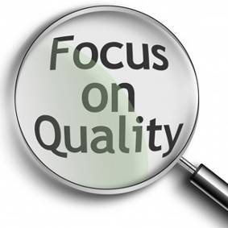
Quality
Ensuring software quality
Software Metrics: Objective assessments of system in form of quantified measurements
Number of transactions
Online response time
Payroll checks printed per hour
Known bugs per hundred lines of code
Testing: Early and regular testing
Walkthrough: Review of specification or design document by small group of qualified people
Debugging: Process by which errors are eliminated
Notes:
27

Slide 28
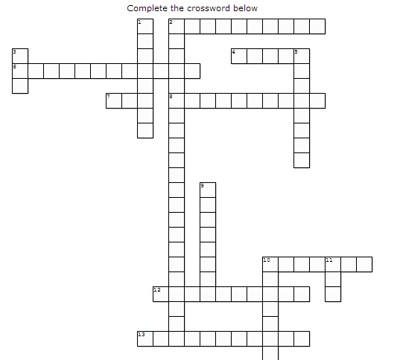
Crossword

Slide 29

Long Question
Question Time
Outline the IT security threats faced by an organization. What actions would you take to improve IT security
Notes:
29

Slide 30

Break Time
10 Minutes break!!

Slide 31
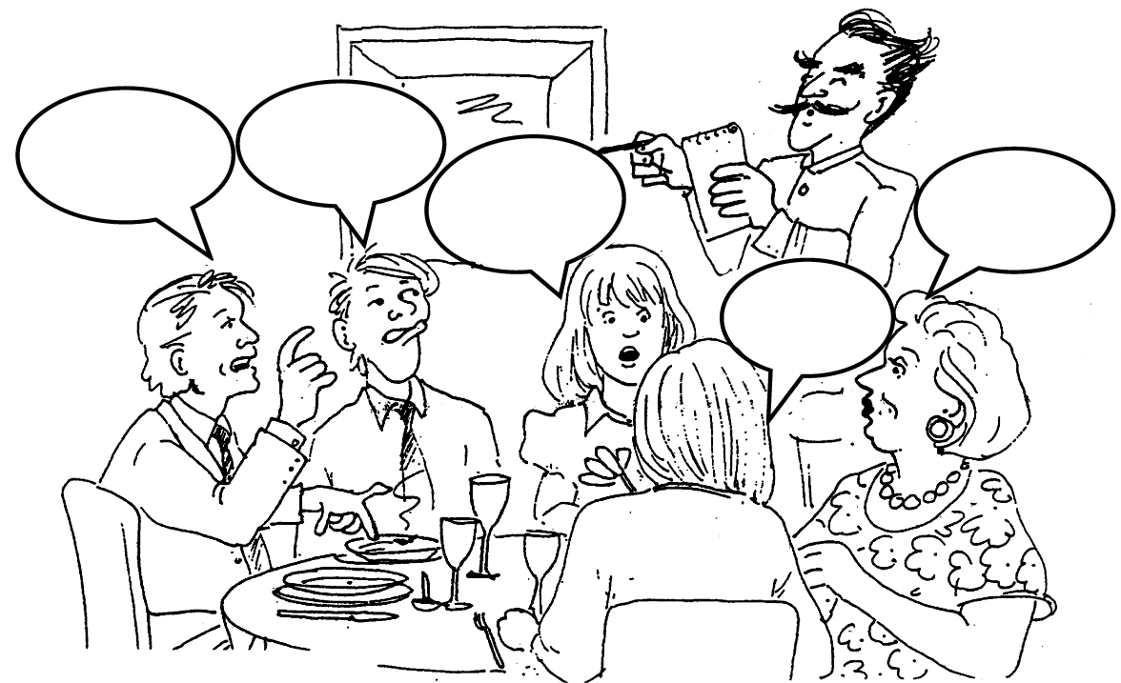
Get ready to Role Play

Slide 32
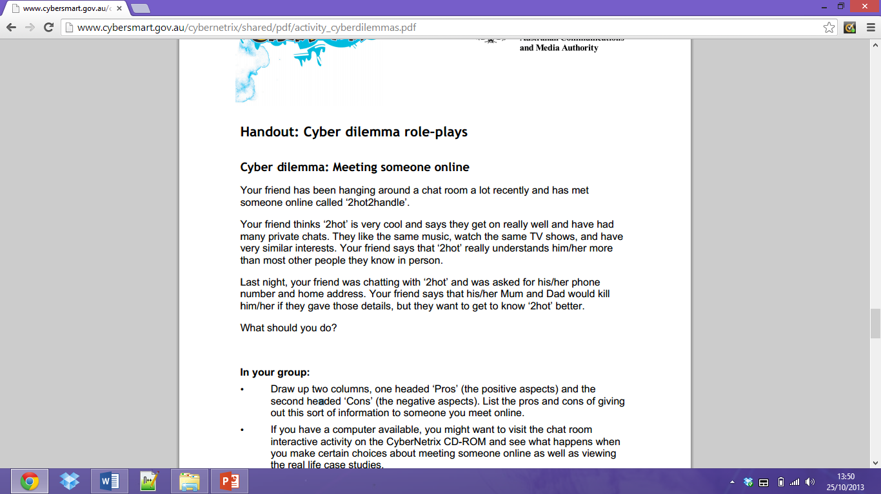

E xercise 3 – Role Play

Slide 33

RECAP
To gain an understanding of the following:
Identify the principal components of telecommunications networks and key networking technologies.
Describe the main telecommunications transmission media and types of networks.
Explain how the Internet and Internet technology work and how they support communication and e-business.
Identify the principal technologies and standards for wireless networking, communication, and Internet access.
Assess the value to business of radio frequency identification (RFID) and wireless sensor networks.

